Slide 1
CDRTs & Stress Management & Psychosocial Support
For Community Disaster Response Teams

Slide 2
Acknowledgements
We thank the Belize Red Cross, Grenada Red Cross, Guyana Red Cross, Jamaica Red Cross, St
Vincent and the Grenadines Red Cross, Trinidad and Tobago Red Cross and the Caribbean
Disaster Emergency Management Agency (CDEMA) for their commitment to collaborating with
the Caribbean Disaster Risk Management (CADRIM) Reference Centre. Together, we reviewed
and revised the CDRT Training Material, enhancing its relevance and effectiveness in disaster
response training. Your dedication exemplifies the spirit of cooperation within the humanitarian
community, and we deeply appreciate your invaluable contributions.

Slide 3
Objectives
Learn about stress, and longterm consequences of stress.
Understand various coping mechanisms
Practice ways of managing stress
Understand psychosocial support
Learn how to care for yourself, your team and disaster victims

Slide 4
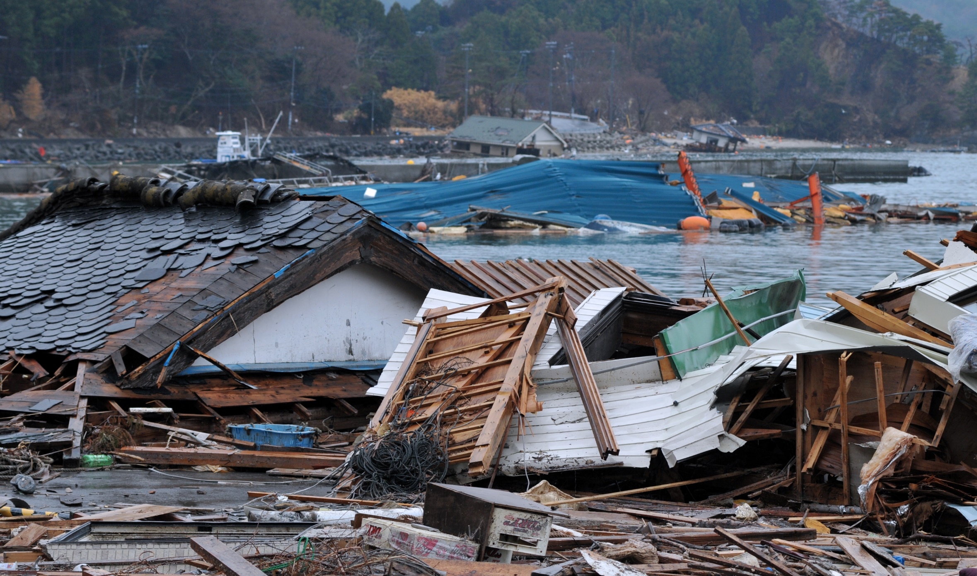
What Is
A Crisis?
An event
Any sudden interruption of the normal course of events in the life of an individual or a society
It is a major event outside the range of ordinary everyday experience that is extremely threatening to those involved – often accompanied by feelings of powerlessness, horror and terror,
Crisis events range from individual incidents to massive disasters and many include, hostage taking, disease outbreaks, hurricanes and floods.

Slide 5
What Is
A Crisis?
A Reaction
Another Definition Of A Crisis As:
" Temporary state of perceived discomfort and disorganization characterized by the inability of an individual to face a specific situation using usual methods of problem solving and the potential for a positive or negative outcome".
Through this definition we understand that people in crisis are not traumatized or have a mental disorder, being in crisis is to react normally to an abnormal situation ( such as an emergency).

Slide 6
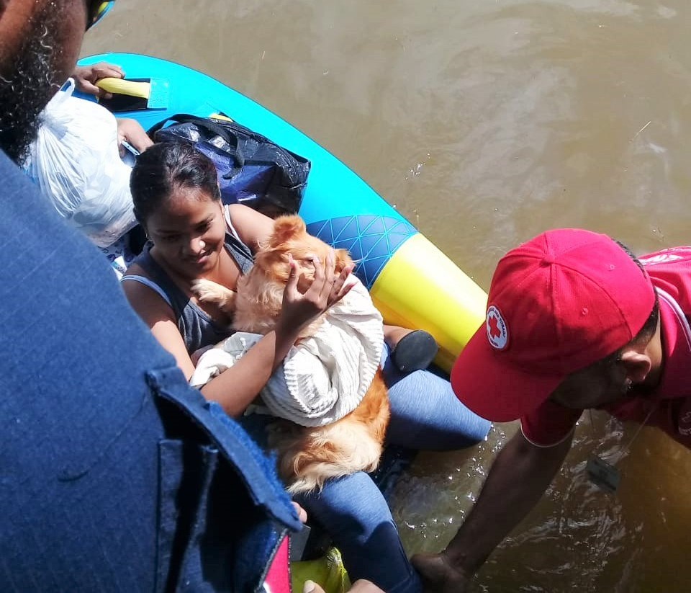
What Is
Stress?
Stress is a normal response to a physical or emotional challenge and occurs when demands are out of balance with resources for coping.

Slide 7
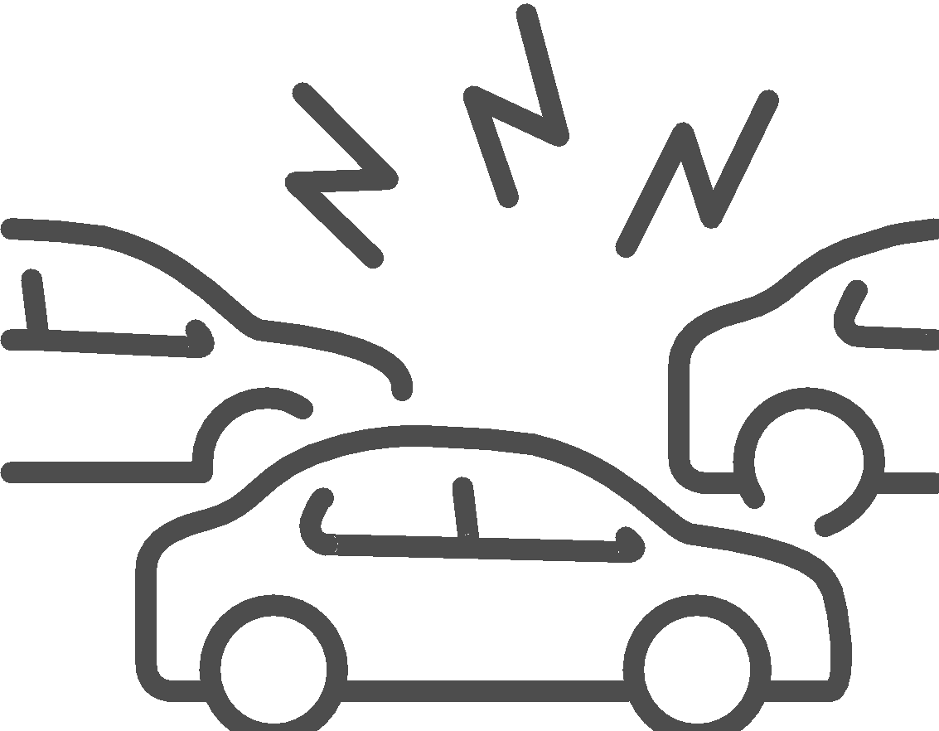
Types Of
Stress
Day To Day Stress:
Those activities defined as routine challenges of day-to-day living, such as the everyday concerns of work, caring for other people, and commuting between work and home.
Cumulative Stress:
Is a common experience for people who work in chronically stressful situations. It results from an accumulation of various stress factors such as heavy workload, poor communications, multiple frustrations, coping with situations in which you feel powerless, and the inability to rest or relax.

Slide 8
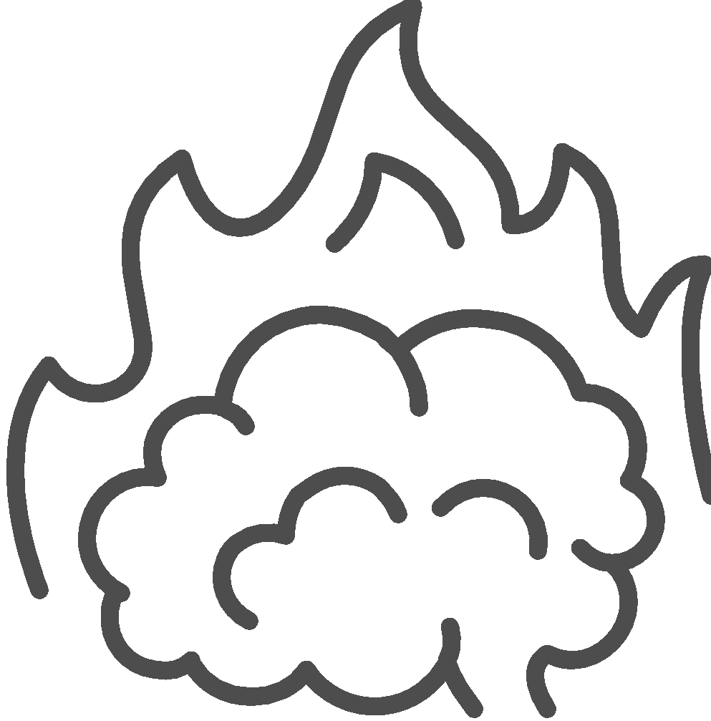
Types Of
Stress
Critical Incident Stress:
One's emotional reaction to a catastrophic event such as a mass casualty incident or the death of a patient or co-worker. Often such events negatively affect the well-being of health care providers.
Burn Out:
Burn out is an exhaustion of normal stress coping mechanisms. Cumulative stress can lead to burnout, which is the point where a person feel completely overwhelmed. Unstable environments and prolonged feelings of lack of support and recognition, lack of control and poor self-care routines can lead to burnout.

Slide 9
Exercise:
Can You Think Of Any Signs Of Stress?

Slide 10
Signs Of Stress
Emotional Fear Anger Nervousness Irritable Sadness Loneliness Hopelessness Moodiness Worry | Mind Repetitive thoughts Confusion Indecisiveness Lack of concentration Loss of confidence Poor memory | Physical Feeling Sick Rapid breathing Stomachache Fast heartbeat Sweating Shaking Dizziness Muscle tension Headache Fatigue Dry mouth Tightness in Chest | Behavioural Lack of sleep Change in appetite Nervous habits Increased drinking, smoking and/or caffeine intake Avoiding situations
Post Traumatic Stress Disorder (PTSD)
is a mental health condition that's triggered by a terrifying event — either experiencing it or witnessing it.
Developed from a natural disaster, armed conflicts, physical assault and abuse, accidents

Slide 11
Long Term Reaction To Stress
Post Traumatic Stress Disorder (PTSD)
is a mental health condition that's triggered by a terrifying event — either experiencing it or witnessing it.
Developed from a natural disaster, armed conflicts, physical assault and abuse, accidents

Slide 12
Long Term Reaction To Stress
Anxiety, fearfulness, nervousness or panic especially when faced by reminders of the event.
Concerns of losing control or not being able to cope, worry that the situation may happen again.
They might be constantly watchful, scanning the environment for danger or seeing threat in things that would have appeared before.

Slide 13
Healthy Coping Strategies
Get Enough Sleep
Balance Work, Play & Rest
Exercise
Connect with others
Eat A Balanced Diet
Allow yourself to receive as well as to give. Remember that your identity is broader than that of a helper

Slide 14
When To Seek
Professional Help
Severe Sleep Disorder
Uncontrollable Strong Emotions
Talk Of Suicide
Persistent Physical Symptoms
Dependency On Alcohol And Drugs
Behaviours That Risk Self Or Others
Lasting Depression Or Mental Disorder Episodes
Where There Are Signs Of Abuse Or Criminal Activity

Slide 15
What Is
Psychosocial Support?

Slide 16
What Is
Psychosocial Support?
A process of facilitating resilience within individuals, families and communities enabling them to bounce back from the impact of a crisis.
It refers to the dynamic relationship between the psychological and social dimensions of a person, and how one influences the other.
A process that helps to deal with such events in the future.
It promotes the restoration of social cohesion and infrastructure.
It helps people recover after a crisis has disrupted their lives.

Slide 17
What Is
Psychological First Aid?
Psychological First Aid is a method of helping people in distress so they feel calm and supported in coping with their challenges. It is a way of assisting someone to manage their situation and make informed decisions.
Psychological first aid is a psychosocial support activity and can be a stand-alone intervention in a crisis situation or a component in a psychosocial support programme that includes other activities.

Slide 18
What Is
Psychological First Aid?
Psychological First Aid is……
Comforting someone who in distress; helping them feel safe & calm
Assessing needs and concerns
Protecting people from further harm
Providing emotional support
Helping to address immediate basic needs, such as food and water, a blanket or a temporary place to stay
Helping people access information, services and social support.

Slide 19
What Is
Psychological First Aid?
Psychological First Aid is NOT……
Something only professionals do
Professional counselling or therapy
Encouraging a detailed discussion of the event that has caused the distress
Asking someone to analyze what has happened to them
Pressing someone for details on what happened
Pressuring people to share their feelings and reactions to an event.

Slide 20
Why Is
Psychological First Aid And Psychosocial Support Important?

Slide 21
The Three
Psychological First Aid Principles
Help people access information
Encourage people connect with loved ones and social support
Tackle practical problems
Access services and other help.
Be mindful of how you approach someone
Introduce yourself
Pay attention and listen actively
Accept others’ feelings
Calm the person in distress
Ask about needs and concerns
Help the person in distress find solutions to their immediate needs and problems.
Information on what has happened and is happening
Who needs help
Safety and security risks
Physical injuries
Immediate basic and practical needs
Emotional reactions.

Slide 22
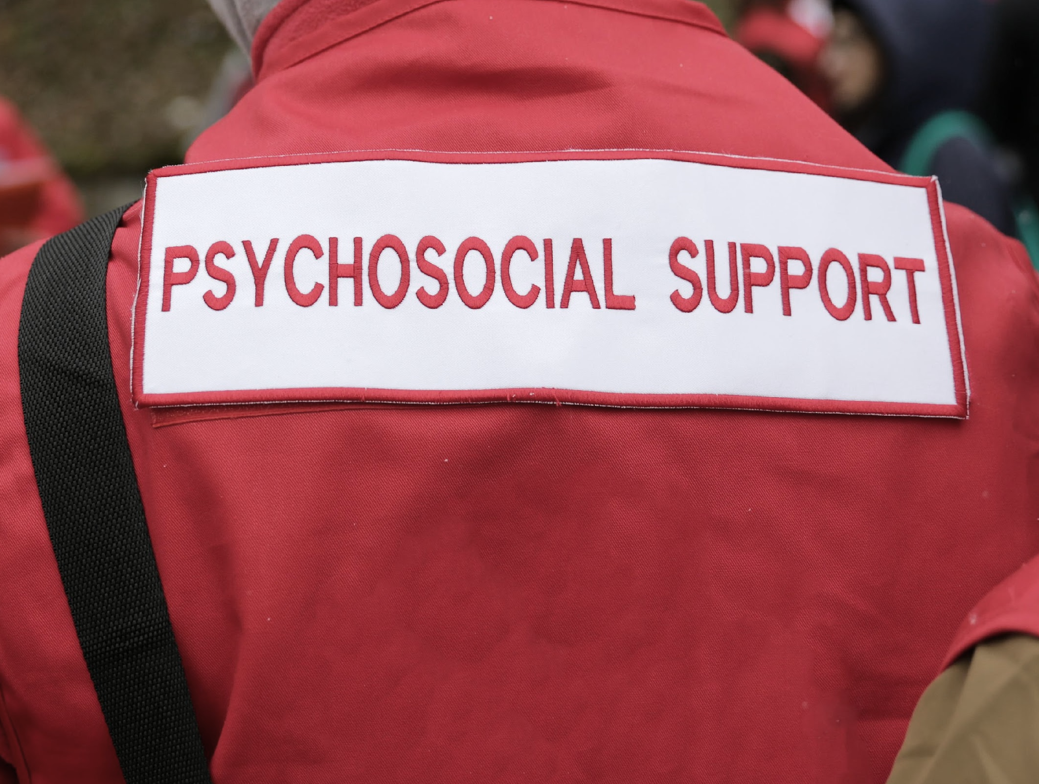
The Advantage Of Using Volunteers
For PSS
Volunteers are often a part of the local community
Local volunteers are often familiar with the culture
Volunteers often have easier access to and the confidence of the affected population as well as local knowledge
Volunteers often intervene in difficult situations in an environment where they themselves are part of that community.

Slide 23
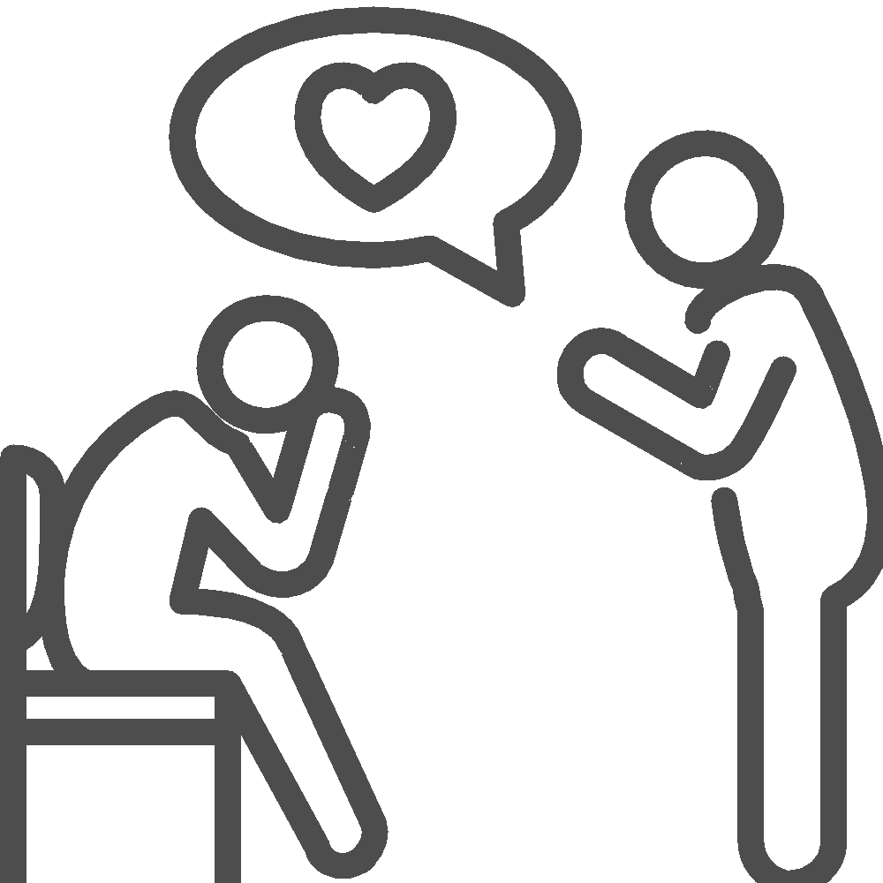
Preparing CDRTs For Psychosocial Stress
Before A Disaster
Provide pre-disaster stress management training to all CDRT personal.
Brief CDRT personnel before the effort begins on what they can expect to see and what they can expect in terms of emotional response in the survivors and themselves.
Emphasize that the CDRT is a team and sharing the workload and emotional load can help defuse pent-up emotions.

Slide 24
Preparing CDRTs For Psychosocial Stress
During A Disaster
Encourage rescuers to rest and re-group
Direct rescuers to take breaks away from the incident area.
Encourage rescuers to eat properly and maintain fluid intake throughout the operation.
Rotate teams for breaks or new duties
Phase out workers gradually.

Slide 25
Preparing CDRTs For Psychosocial Stress
After A Disaster
Conduct a brief discussion (defusing) with workers after the shift, in which workers describe what they encountered and express their feelings about it.
Arrange for a debriefing 1 to 3 days after the event in which workers describe what they encountered and express their feelings about it in a more in-depth way.

Slide 26
Providing Psychosocial Support During A Disaster
By being available and listening to how a distressing event has affected a family
By contacting relatives in extreme cases where you believe the person may cause themselves harm
By assisting them in organising practical matters
By encouraging and supporting community initiatives e.g. Home-based support, school-based interventions, vocational and skills-based training, establishing community centres.
By establishing support groups.

Slide 27
Attitudes And Phrases To Avoid
X
X
X
X
X
X
“I understand.”
“Don’t feel bad.”
“You’re strong/You’ll get through this.”
“Don’t cry.”
“It’s God’s will.”
“It could be worse” or “At least you still have …”

Slide 28
What Do
You Do?
State 3 Things
State 3 Things
You could do to "bounce back".
You could do to combat stress.
State 3 Things
Tell Us!
A community could do to "bounce back"

Slide 29
Bounce Back
What Is Resilience?
Resilience can be understood as a person's ability to survive, and eventually thrive, after a particularly stressful event takes place. It includes the ability to develop the necessary skills to manage future hardships.
Psychological resilience refers to the possession of cognitive, emotional, physical and social skills.

Slide 30
Summary
Psychosocial support can be both preventive and curative.
It is preventive when steps are taken to decrease the risk of developing mental health problems.
It is curative when steps are taken to help individuals and communities to overcome and deal with the psychosocial effects that may occur in response to a crisis,
These two aspects of psychosocial support contribute to the building of resilience in the face of a new crisis or other challenging life circumstances.

Slide 31
Activity
Identify persons within your community who can provide psychological first aid and psychosocial support.
Identify persons within your National Society or National Disaster Office who can reach out to for support.
Note: You can also reference Unit 5 on page 13 of the CDRT Workbook

Slide 32
Volunteer, Donate, Join Us In Partnership, or share our appeals and stories on social media. Find out more about IFRC and learn how to contact your National Red Cross or Red Crescent Society, at www.ifrc.org.
Get Involved
There are many ways of becoming a part of the world’s largest humanitarian network
To stay informed about Caribbean disaster response activities or to access additional information on available trainings, training materials, research and information management tools, visit: www.cadrim.org.
: CADRIM.IFRC
: @cadrim_ifrc
: @CADRIM_IFRC

