Slide 1
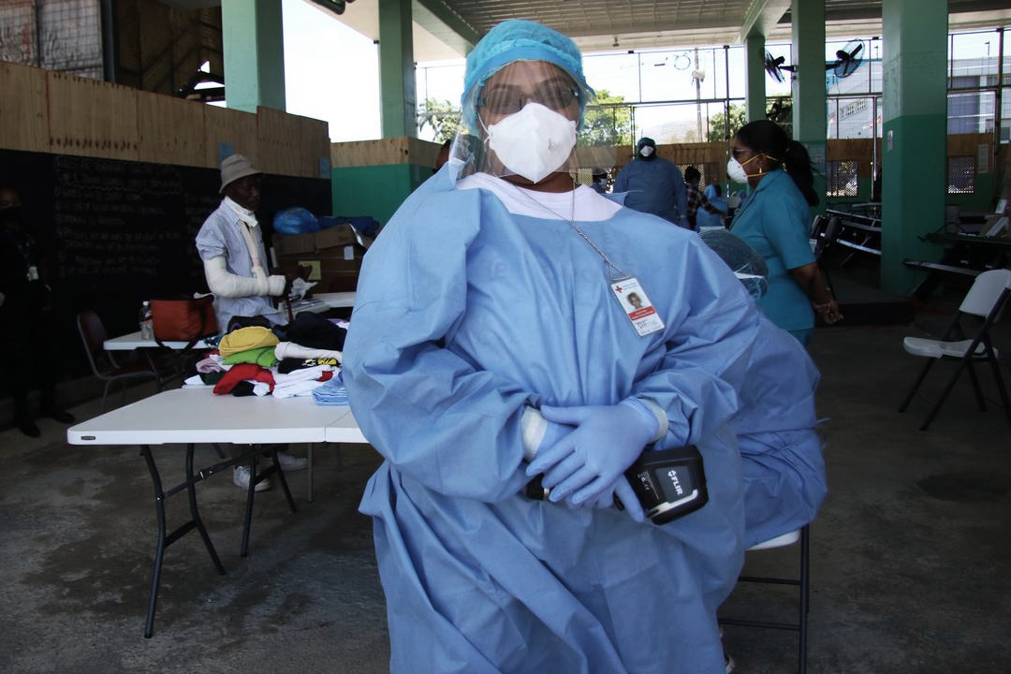
CDRTs & Health in Emergencies
For Community Disaster Response Teams

Slide 2
Acknowledgements
We thank the Belize Red Cross, Grenada Red Cross, Guyana Red Cross, Jamaica Red Cross, St
Vincent and the Grenadines Red Cross, Trinidad and Tobago Red Cross and the Caribbean
Disaster Emergency Management Agency (CDEMA) for their commitment to collaborating with
the Caribbean Disaster Risk Management (CADRIM) Reference Centre. Together, we reviewed
and revised the CDRT Training Material, enhancing its relevance and effectiveness in disaster
response training. Your dedication exemplifies the spirit of cooperation within the humanitarian
community, and we deeply appreciate your invaluable contributions.

Slide 3
Objectives
Learn The Effects of Disasters on Health & Vulnerable Groups
Identify Common Diseases In Emergencies
Understand CDRT’s Role In Risk Assessment Activities
Obtain Information on Preventive measures For Communicable Diseases
Life-threatening Conditions- Airway Obstruction, Controlling Bleeding and Treating Shock
Understand The Basics Of Triage

Slide 4
What Is Health?
“Health is a state of complete physical, psychological, and social well-being and not simply the absence of disease or infirmity.”
(World Health Organization, 1948)

Slide 5
Effects Of
Disasters On Health
Increased Communicable Diseases
& Disease Epidemics
Lack Of Proper Shelter & Protection
Poor Nutrition
Poor Access
To Health Care
Negative Impact On Mental Health

Slide 6
What Are We
Looking For?
Who
What
Who is most affected?
What are some of the health concerns?
Where
How
Where are most affected persons located?
How can they be impacted?
Notes:
Decision makers need adequate, sufficiently accurate and reliable information at the appropriate time to enable them to make informed decisions – both at strategic and operational levels

Slide 7
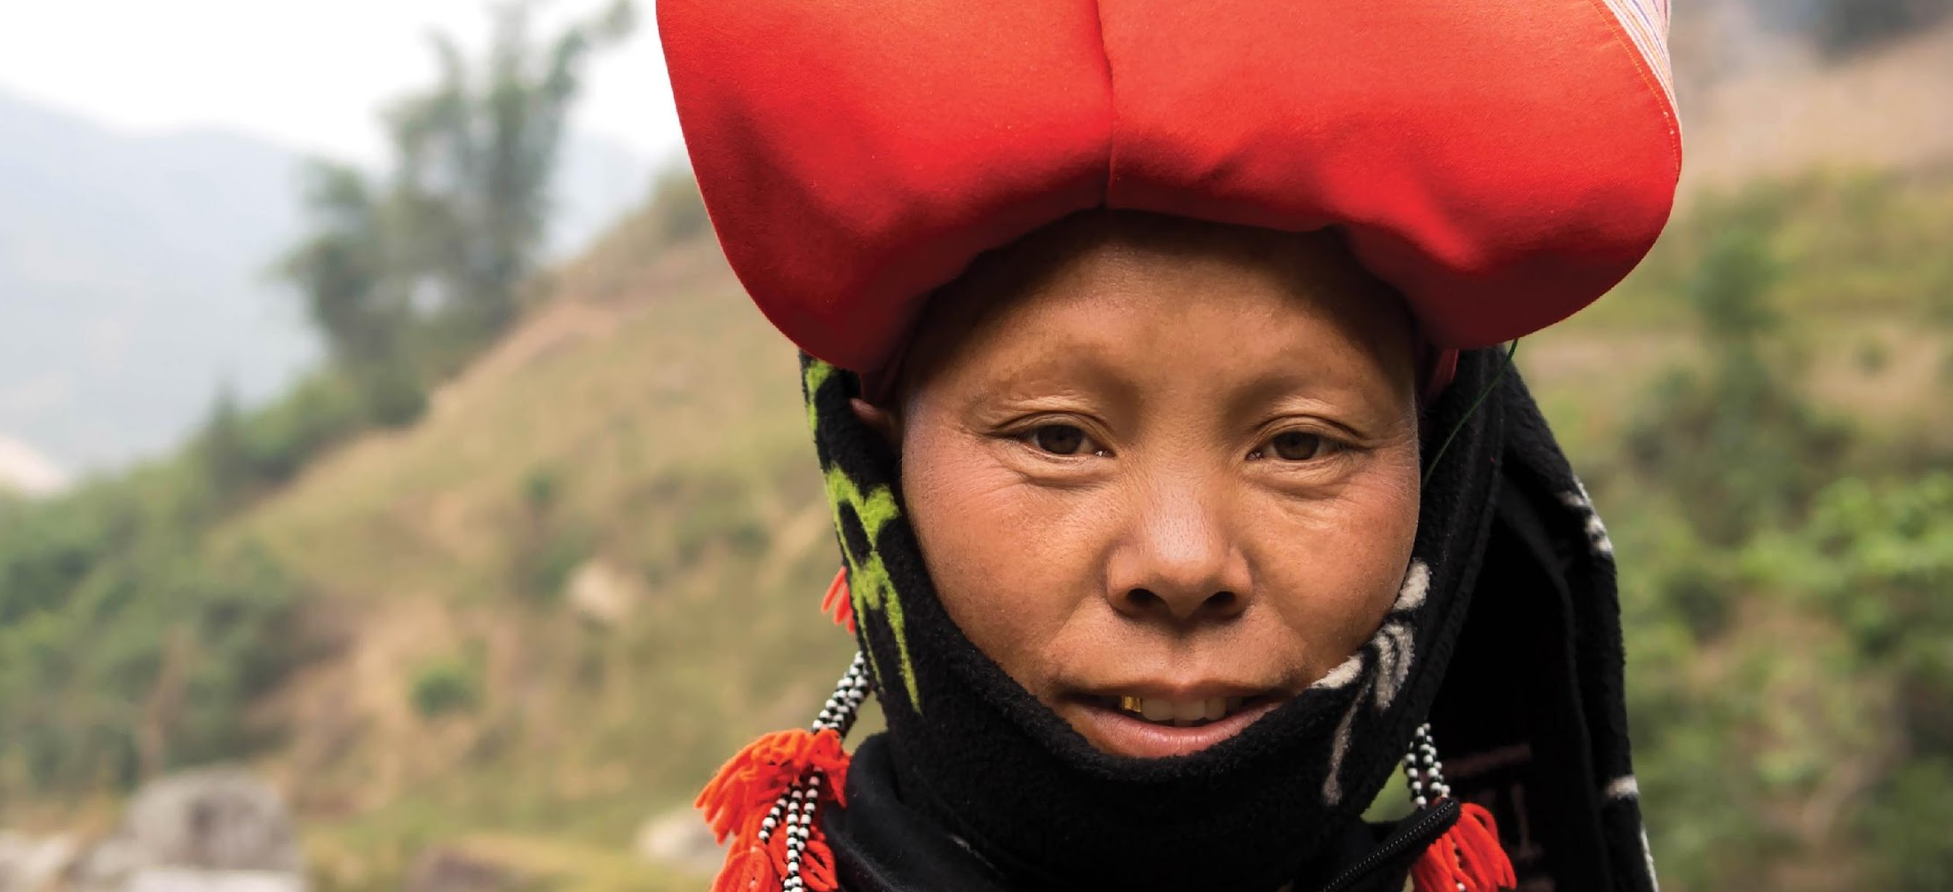
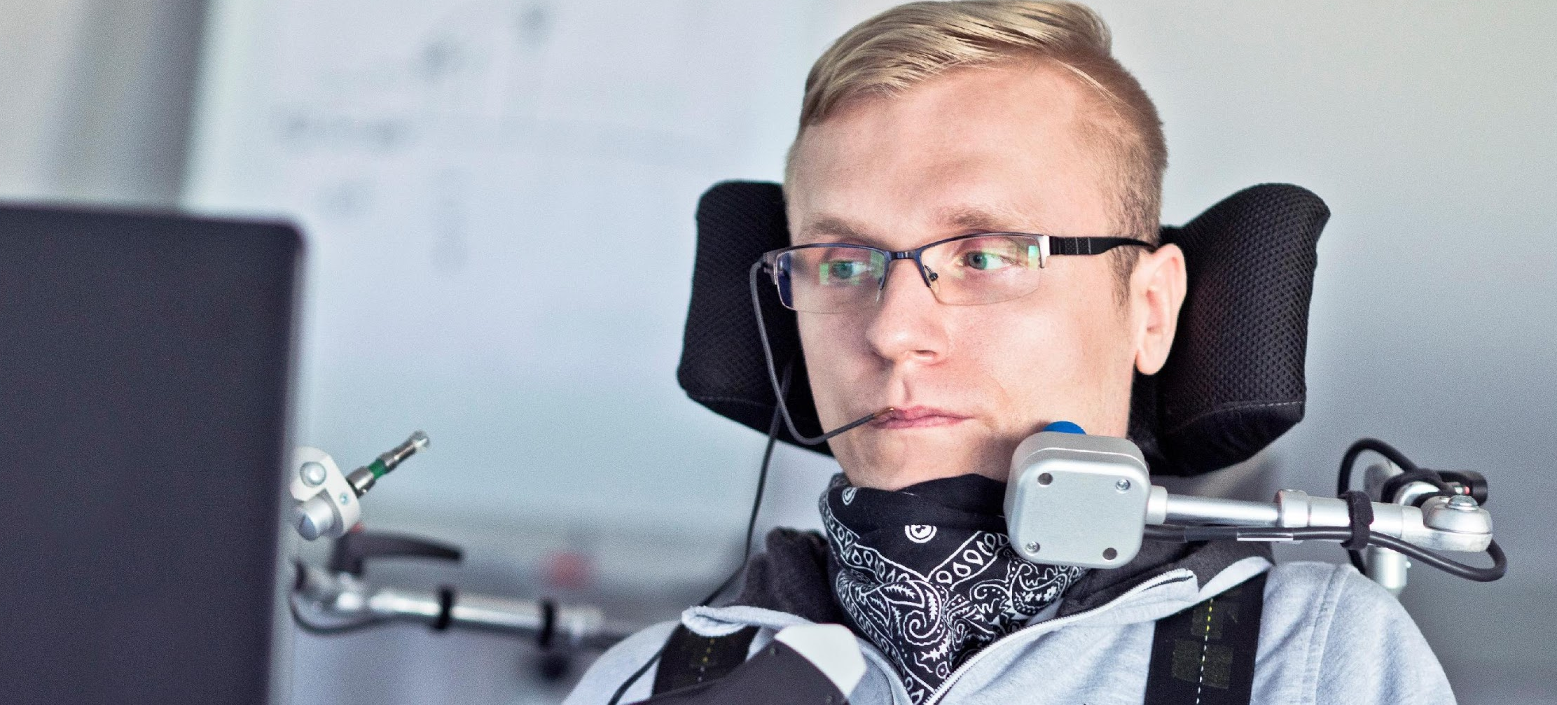
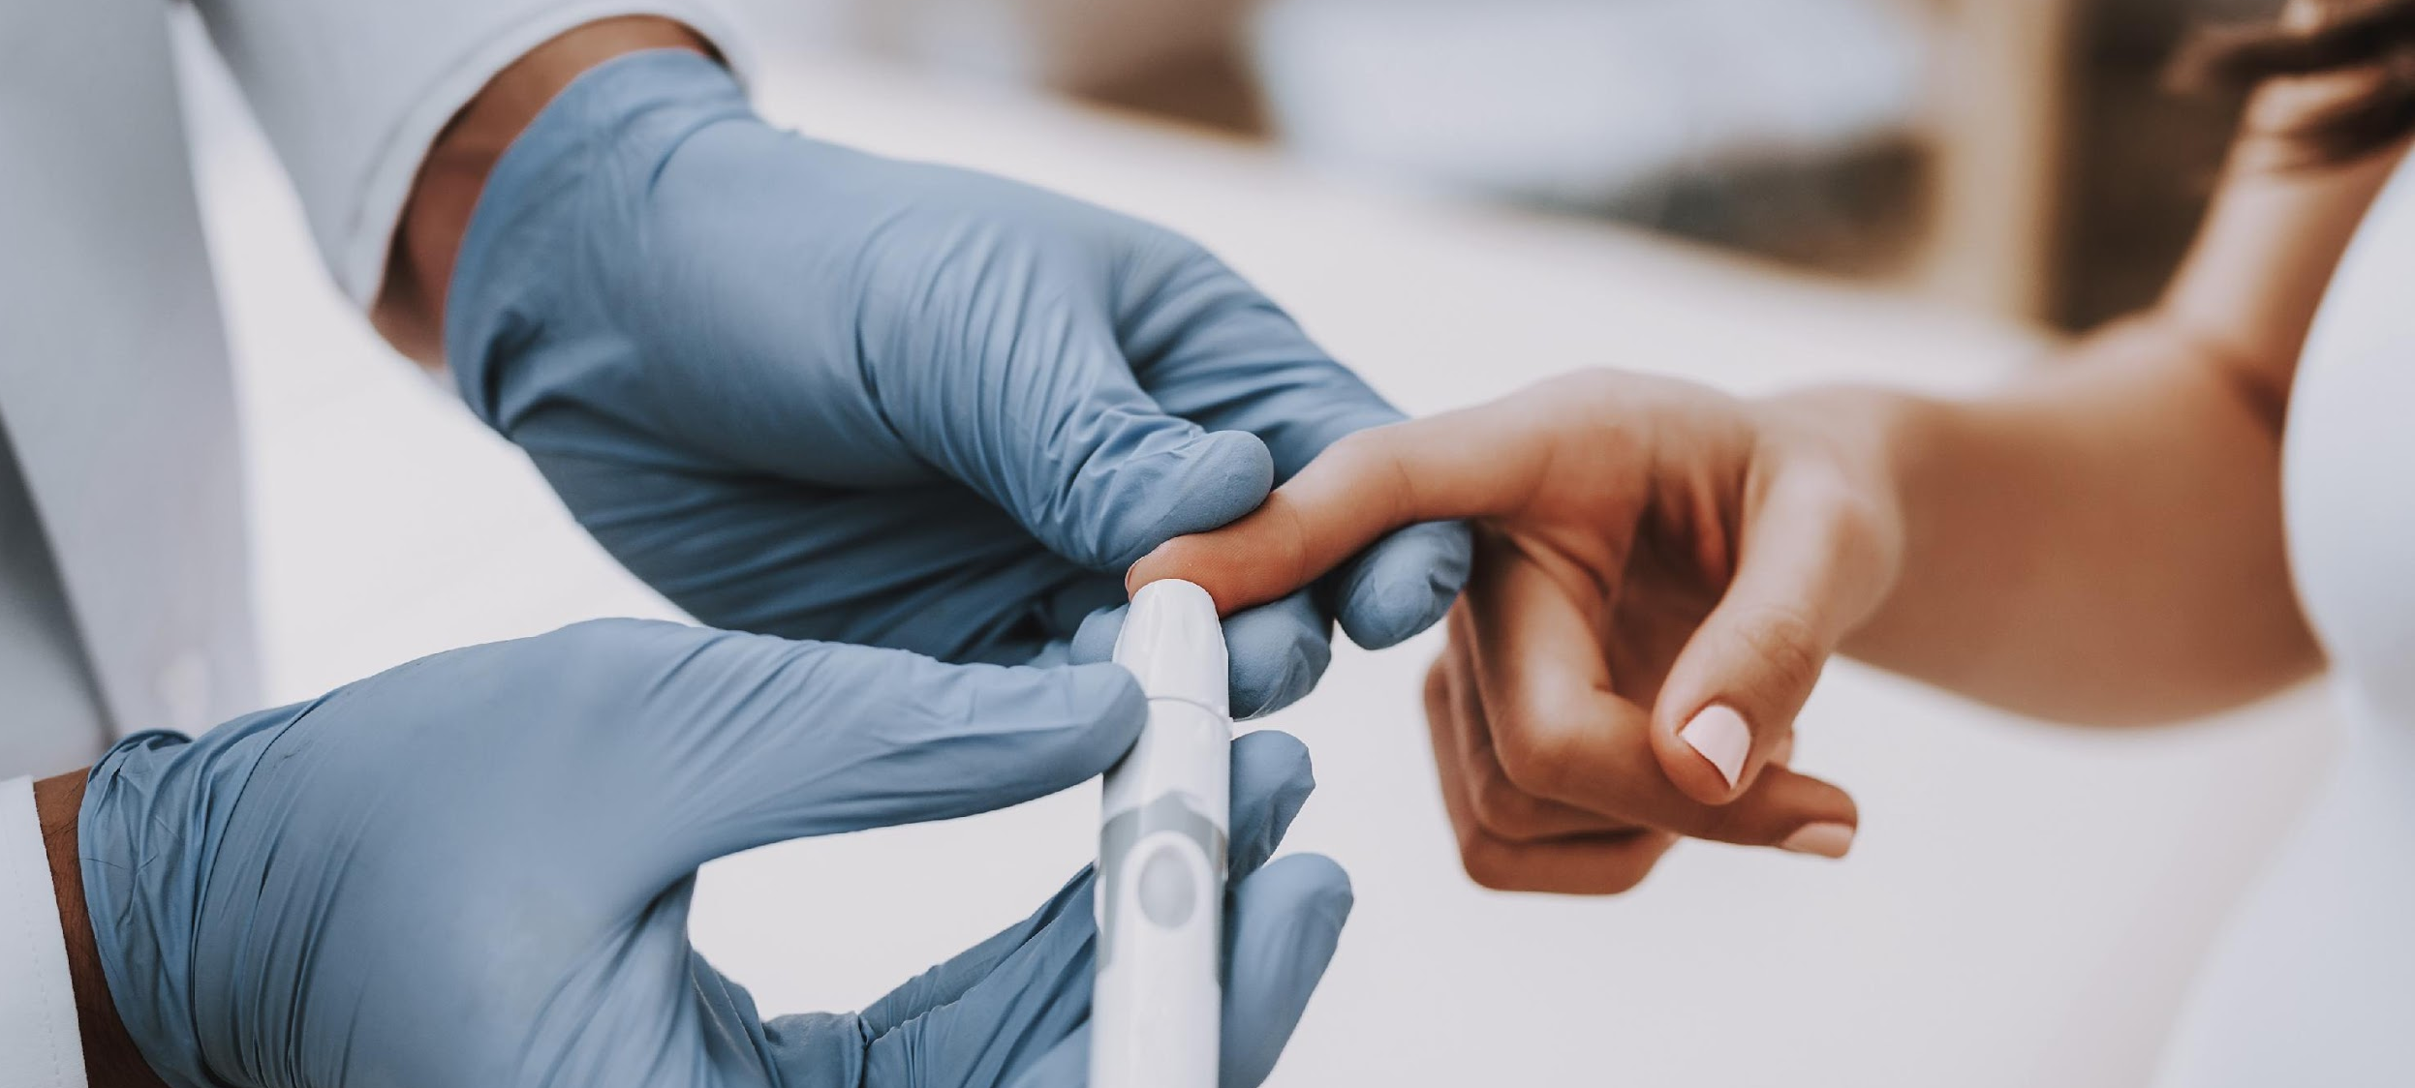
Vulnerable Groups
To Consider
Pregnant & Lactating Women (PLW’s)
Children Under
5 Years
Older Persons
Minority Ethnic Groups (Information Dissemination
& Language Barriers)
Persons With
Disabilities
People Living With A Chronic Disease Diabetes, HIV/AIDS

Slide 8
Risk Factors
Poor Access To Safe Water & Adequate Food
Poor Sanitation
& Hygiene Practices
Overcrowding
Seasonal Changes
Displaced Populations
Lack Of Access To Treatment
Underlying Conditions
Low Levels Of Immunity
(Have these diseases been in the
community before or are they new?)

Slide 9
CDRT’s Role In Helping
Manage An Epidemic
Assisting with Community Preparedness
Monitoring outbreaks & contacting relevant health officials
Responding appropriately and assisting with the mobilization of volunteers & education of the community
Reporting any changes in community that can have a negative impact on health
Notes:
It is important that volunteers and community members prepare for certain epidemic outbreaks in their community. In doing so CDRT members need to include in the community disaster plans ways to deal with epidemic outbreaks within the community and household levels.

Slide 10
Assessing Risk For
Potential Health Threats
Assisting with
Community Preparedness
Community Risk
Assessment
Rapid
Assessment
Surveillance

Slide 11
Surveillance
Of Diseases After Disasters
After some disasters, the ability of the health sector to respond to diseases is overwhelmed.
In select cases Red Cross volunteers may be called upon to assist local health authorities in collecting data about a specific disease and its spread.
Even where Red Cross volunteers do not have a formal surveillance role it is important to report symptoms that you see to relevant field officers. (e.g. many cases of diarrhea in one shelter.)
All people who report illness should be referred to the nearest health clinic.

Slide 12
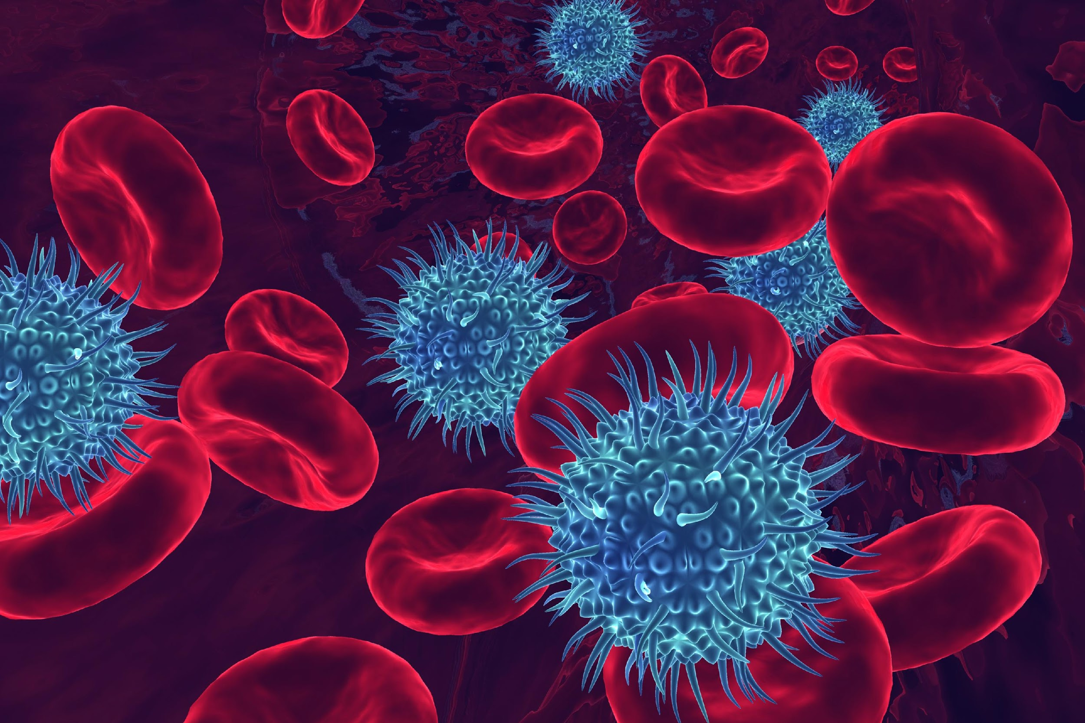
Diseases In
Emergencies

Slide 13
Non communicable Diseases
Health conditions which cannot be spread from person to person.
They require ongoing treatment.
Types of Noncommunicable Diseases
Cardiovascular diseases
Diabetes
Cancer
Chronic lung diseases.

Slide 14
Impacts of Disasters on Persons with NCDs
The health of persons with NCDs can deteriorate as a result of the following:
Direct physical injury.
Loss of access to prescribed medication
Lack of water and food can add to physical and psychological stress
Lack of access to health services

Slide 15
How to Prepare?
Include a backup supply of prescribed medication in your disaster kit.
Store appropriate non-perishable foods in your disaster kit.
Include instructions for emergency care in your family emergency plan.

Slide 16
Types of Communicable Diseases
Communicable Diseases
Communicable diseases spread from one person to another or from an animal to a person.
The spread often happens via airborne viruses or bacteria, but also through blood or other bodily fluid.
The terms infectious and contagious are also used to describe communicable disease
Air-Bourne
Water-Bourne
Direct Contact
Vector Bourne

Slide 17
Human
To Human
Direct
Sneezing
Coughing
Touching
Mother to Unborn Baby
Indirect
Touching something that’s Infected
Drinking after someone with an infectious disease

Slide 18
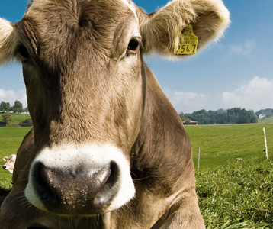
Animal
To Human
Direct
Eating Animals
Bugs Biting You
Getting Scratched
Getting Stung
Indirect
Petting Animals then touching your eyes, nose or mouth
Drinking water after an infected Animal

Slide 19
Plant
To Human
Direct
Eating Unwashed Fruits & Vegetables
Touching Fruits then putting your fingers in your eyes or mouth

Slide 20
Air Bourne
Germs spread through the air.
(E.g. When someone sneezes or coughs.)
Examples of Common Air Borne Diseases
Influenza like illnesses (H1N1 & Swine Flu)
Measles
Whooping Cough
Chicken Pox
Tuberculosis
Pneumonia & Other Respiratory Diseases

Slide 21
Water Bourne
Water contaminated with germs can cause illness on ingestion or skin contact.
Examples of Common Water Borne Diseases
Gastroenteritis
Cholera
Infection with Water Borne diseases most often result
in Diarrhea

Slide 22
Diarrhea
Diarrhea is defined as the passage of three or more loose or liquid stools per day (or more frequent passage than is normal for the individual).
Frequent passing of formed stools is not diarrhea, nor is the passing of loose, "pasty" stools by breastfed babies.
The most severe threat posed by diarrhea is dehydration. During a diarrheal episode, water and electrolytes are lost through liquid stools, vomit, sweat, urine and breathing. Dehydration occurs when these losses are not replaced.

Slide 23
Other Modes Of Diarrheal Disease Transmission
Water Borne
Food Borne
Easy to spread in overcrowded conditions with poor access to sanitation and safe water, poor hygiene

Slide 24
Vector Bourne
A vector is a disease-carrying agent, normally an insect or animal and vector-borne diseases are a major cause of sickness and death in many disaster situations.
Main Vectors For Diseases: Mosquitos
DAYTIME BITING
Aedes
Chikungunya
Dengue Fever
Yellow Fever
Zika
NIGHT-TIME BITING
Anopheles
Malaria
Culex
West Nile Fever

Slide 25
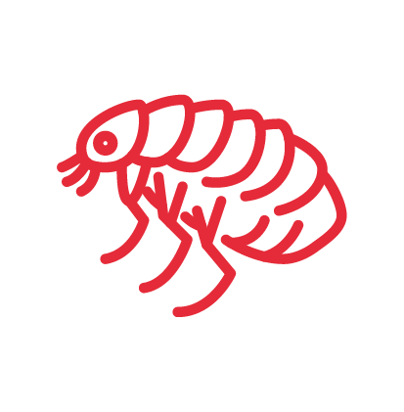
Main Vectors
For Disease Transmission
Ticks
Lyme Disease
Rickettsia
Bedbugs & Fleas
West Nile Fever
Rats & Mice (Urine Contact)
Leptospirosis
Rickettsia
Flies
West Nile Fever

Slide 26
Preventative
Measures

Slide 27
Proper Sanitation Measures
Ensure safe excreta disposal
(latrine construction when necessary)
Proper solid waste collection and disposal
Community education and mobilization to reduce standing water where mosquitoes are likely to breed
Wash fruits and vegetables before eating
Do not eat raw or undercooked meat or eggs

Slide 28
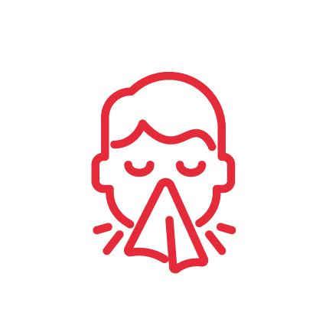
Personal Hygiene Measures
Wash your hands thoroughly and regularly using soap and water or an alcohol base sanitizer
Cover your mouth with a tissue when you sneeze or cough
Proper daily dental hygiene

Slide 29
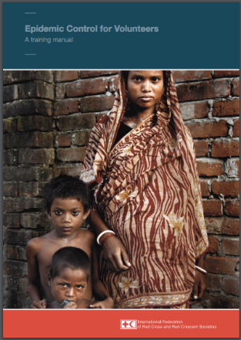
ECV: Epidemic Control For Volunteers
Training manual
Disease tools
Action tools
Community Message Tools
Access the revised toolkit online at: http://ifrcgo.org/ecv-toolkit/
Notes:
For more information, you can access this document

Slide 30
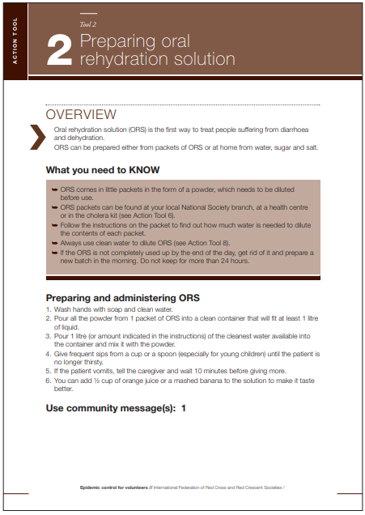
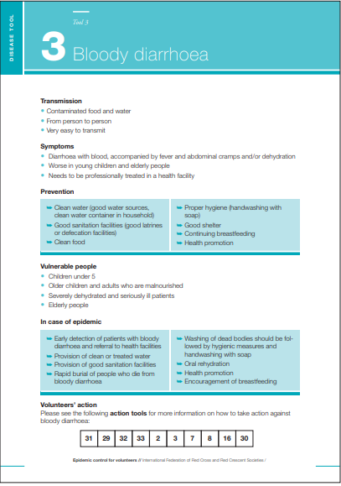
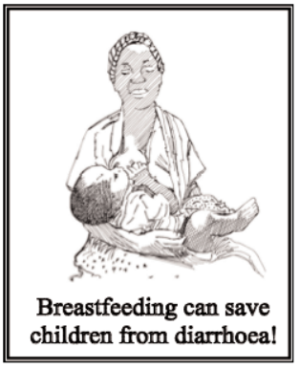
Disease, Actions &
Community Message Tools
Notes:
Visit the PAPE E-Library on CADRIM’s website for messages: https://www.cadrim.org/pape-e-library

Slide 31
Community Based Health And First Aid (eCBHFA)
RCRC approach used to empower communities to identify and address their health issues
Volunteers are trained in 5 core modules and develop community action plans with the community
Prevention modules are implemented based on community needs and action plans
Related eCBHFA prevention modules:
http://ifrc-ecbhfa.org/guides-and-tools/
Health in Emergencies
Communicable Disease Prevention

Slide 32
Life-Threating Conditions
The three main “Killers” in a medical emergency
Airway Obstruction
Bleeding
Shock

Slide 33
Head-Tilt/ Chin-Lift Method For Opening An Airway
Treating an Airway Obstruction- Opening
the
Airways
STEP | ACTION
1 | At an arm’s distance, shake the victim by touching the shoulder and shout, “Can you hear me?”
2 | If the victim does not or cannot respond, place one hand on the forehead.
3 | Place two fingers of the other hand under the chin and tilt the jaw upward while tilting the head back slightly.
4 | Look for chest rise.
5 | Listen for air exchange.
6 | Feel for abdominal movement.
Notes:
A victim with a suspected airway obstruction must be checked immediately for breathing and, if necessary, the airway must be opened.
When the victim is not breathing, use the Head-Tilt/Chin-Lift method of opening the airway.

Slide 34
Treating Bleeding- Types of Bleeding
Three Main Types Of Bleeding
Arterial Bleeding:
Arteries transport blood under high pressure - spurting bleeding.
Venous Bleeding:
Veins transport blood under low pressure - flowing bleeding.
Capillary Bleeding:
Capillaries also carry blood under low pressure - oozing bleeding.

Slide 35
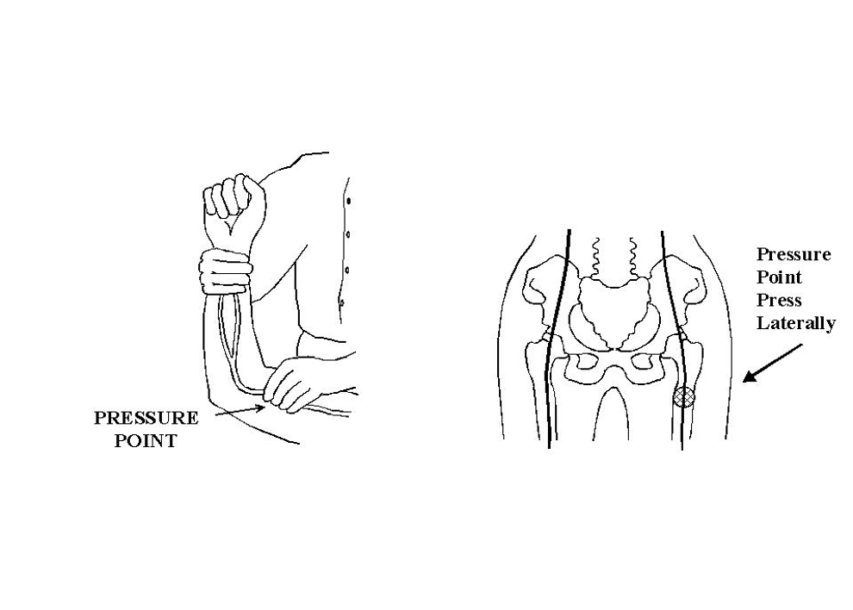
Treating Bleeding- Control Bleeding
Brachial Pressure Point
Femoral Pressure Point

Slide 36
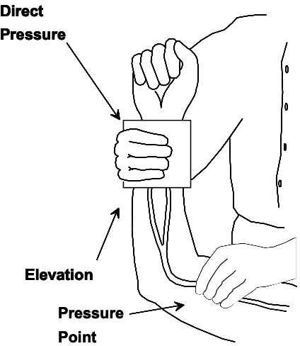
Treating Bleeding- Control Bleeding
Methods for Controlling Bleeding by using direct pressure on wound, elevation, and pressure points.

Slide 37
Treating
For Shock – Signs of Shock
The Main Signs Of Shock To Look For Are:
Rapid and shallow breathing.
Failure to follow simple commands, such as, “Squeeze my hand.”
Changes in skin color.
Capillary refill (how long it takes for the color to return) is greater than 2 seconds

Slide 38
Treating
For Shock -
Controlling Shock
Step | Action
1 | Lay the victim on his or her back. Elevate the feet 6-10 inches above the level of the heart. Maintain an open airway.
2 | Control obvious bleeding.
3 | Maintain body temperature (e.g., cover the ground and the victim with a blanket if necessary).
4 | Avoid rough or excessive handling unless the rescuer and victim are in immediate danger.

Slide 39
Volunteer, Donate, Join Us In Partnership, or share our appeals and stories on social media. Find out more about IFRC and learn how to contact your National Red Cross or Red Crescent Society, at www.ifrc.org.
Get Involved
There are many ways of becoming a part of the world’s largest humanitarian network
To stay informed about Caribbean disaster response activities or to access additional information on available trainings, training materials, research and information management tools, visit: www.cadrim.org.
: CADRIM.IFRC
: @cadrim_ifrc
: @CADRIM_IFRC

